Slide 1
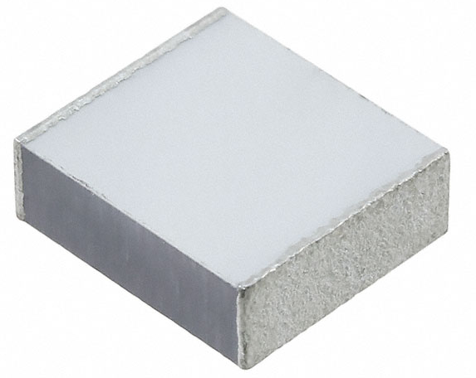
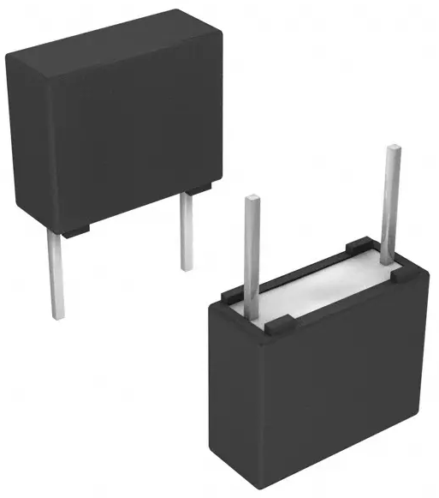
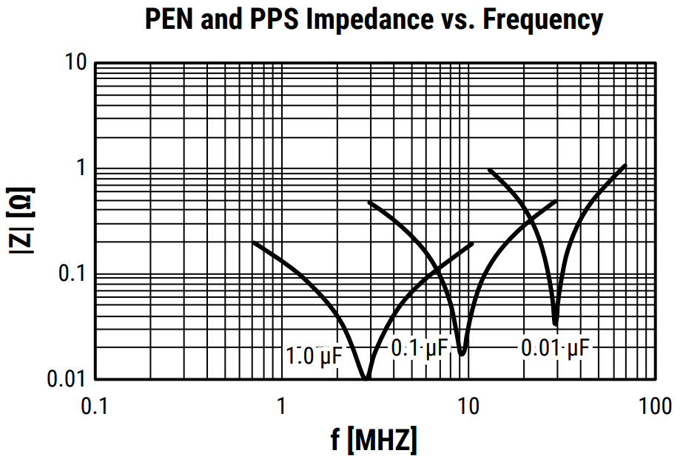
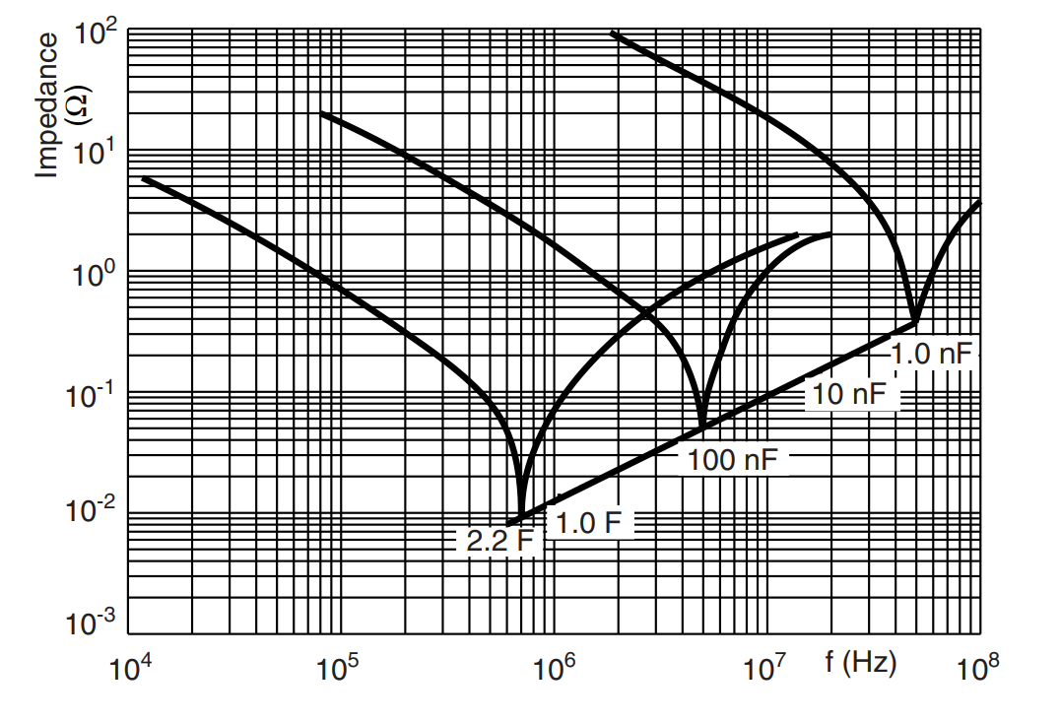
Capacitor Selection
(x2)
(x1)
SMD component – 0.22uF
(LDEPH3220KA5N00)
+
= 6 Capacitors: 3 Inp + 3 Out
TH component – 0.68uF
(BFC238320684)

Slide 2
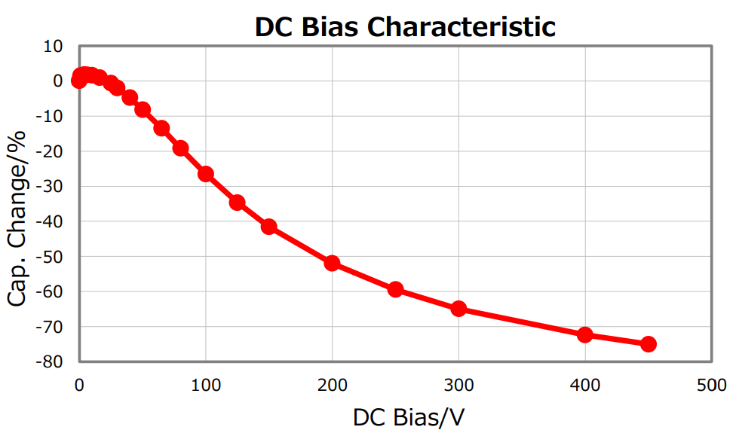
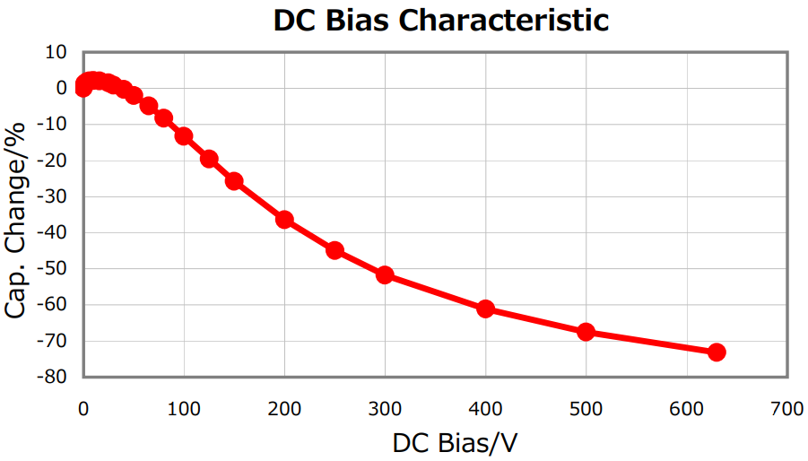
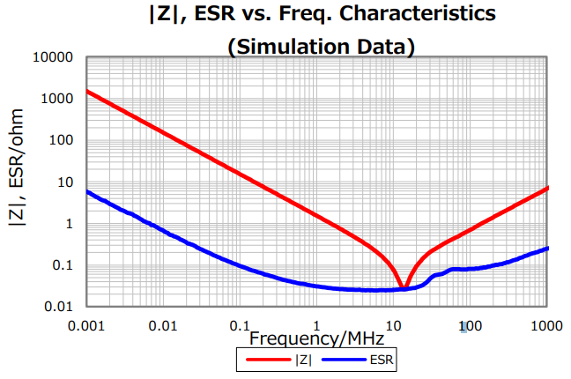
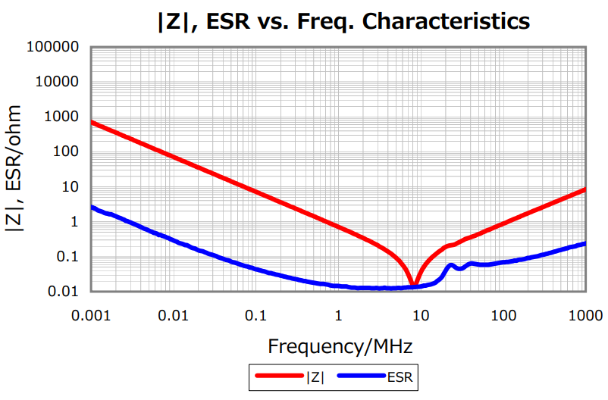
Capacitor Selection – Bypass Capacitor
IMMD Bypass Capacitors
C3216X7T2W104K160AE – 1206 Package
Capacitance: 100 nF
ESL: 0.75 nH
ESR: 17.5 mohm
Voltage: 450 Vdc
Buck Conv. Bypass Capacitors
C4532X7T2J224M200KC – 1812 Package
Capacitance: 220 nF
ESL: 0.7 nH
ESR: 13.4 mohm
Voltage: 630 Vdc
Effective Capacitance
35 nF
Effective Capacitance
66 nF
Low number of this capacitor can be used

Slide 3
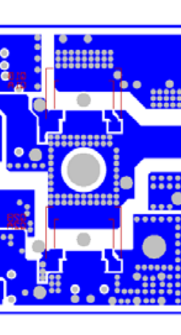
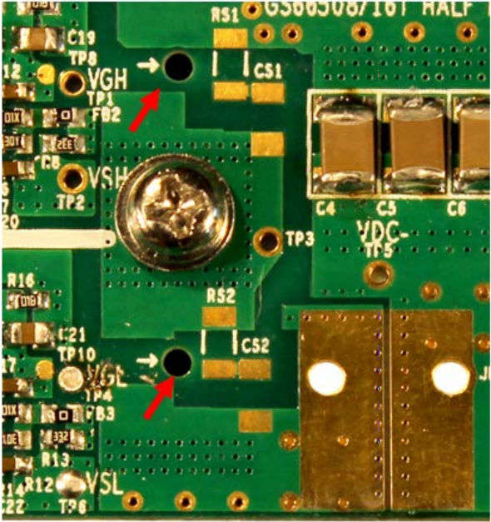
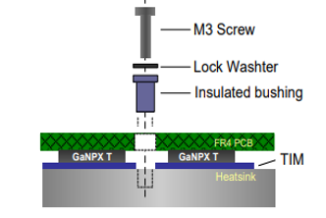
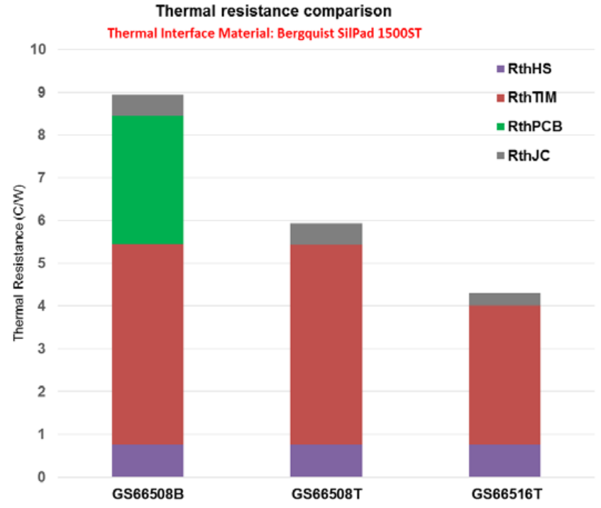
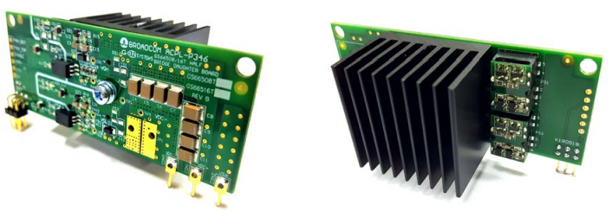
Heat Sink Selection – Daughter Board Example
TIM is the bottleneck
Important Disadvantage for Bottom Cooled Transistors
Thermal pad of 516T is 2.3 times of 508T’s thermal pad

Slide 4





Heat Sink Selection – Thermal Resistance Calculation
Assumptions:
Losses are calculated as 4.6 W and 3.8 W for top and bottom transistors. These losses are assumed as 6 W.
Ambient temperature is assumed as 40 ˚C.
Operation temperature is set as 120 ˚C.
Junction-to-case thermal resistance is taken from datasheet and its value is 0.45 ˚C/W.
TIM is selected as A17682-008 and its thermal resistance is calculated as 3.56 K/W. (A better option is A10092-01 and its thermal resistance is 2.28 K/W)
$$R_{TIM}=α ∗{\left(25.4\right)}^{2}∗\frac{1}{(Length_{mm}∗Width_{mm}∗{1.5}^{2})}$$
$$α is thermal impedance in °C∗\frac{in^{2}}{W}$$
$${R_{th}}_{total}=\frac{T_{j}−T_{amb}}{P_{loss}}$$
$${R_{th}}_{total}−R_{TIM}−R_{JC}=8∗R_{HS}$$
$${R_{th}}_{total}−R_{TIM}−R_{JC}=8∗R_{HS}→R_{HS}≅1.21 °C/W$$
OR
$R_{HS}≅2.4 °C/W$ for seperate bridges

Slide 5
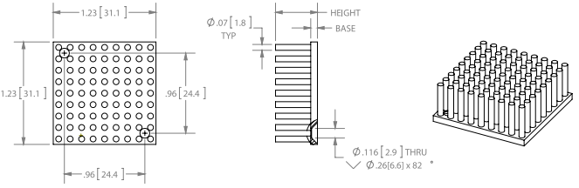
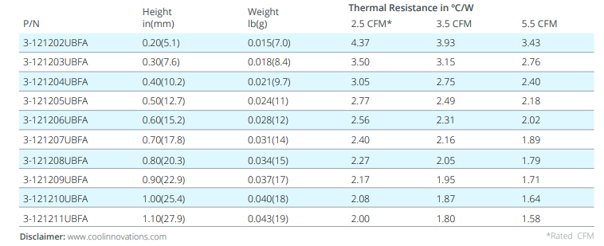
Heat Sink Selection – Option #1
Air flow (CFM) is proportional to thickness of fan and its power
240.13 LFM - 1.22 m/s
Link

Slide 6
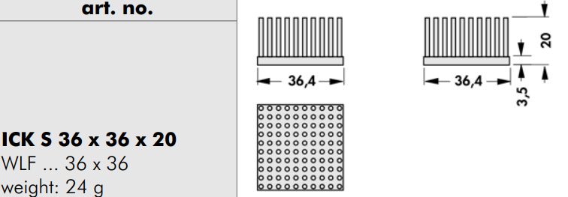
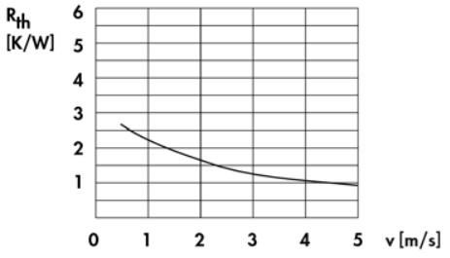
Heat Sink Selection – Option #2
@ 2.75 CFM & 197 LFM
Link - NonStock

Slide 7
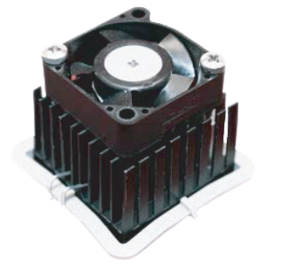
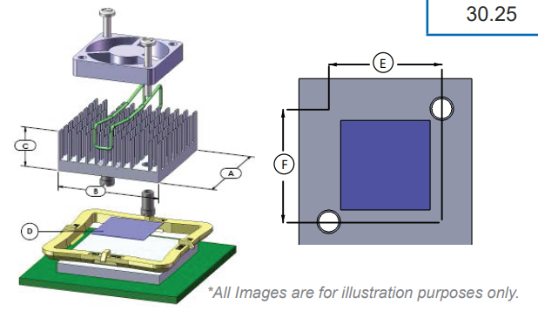
Heat Sink Selection – Option #3
L x W x H – 30.25 x 30.25 x 14.5 - 2.1 C/W @ 200LFM, 1 m/s, 2 CFM
Link

Slide 8
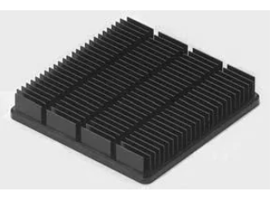
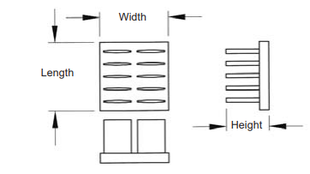
Heat Sink Selection – Option #4
L x W x H – 30 x 30 x 12.7 - 2.7 C/W @ 200LFM, 1 m/s, 2 CFM
L x W x H – 40 x 40 x 9.5 – 2.5 C/W @ 200LFM, 1 m/s, 3.44 CFM
Link

Slide 9
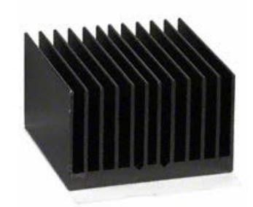
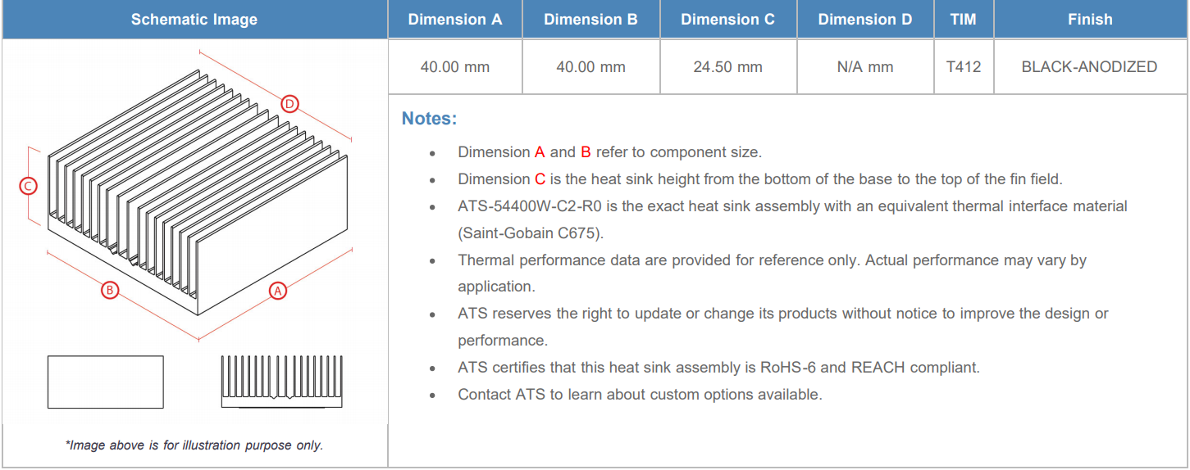
Heat Sink Selection – Option #5
L x W x H – 40 x 40 x 24.5 – 2.4 C/W @ 200LFM, 1 m/s, 3.44 CFM
Link

Slide 10
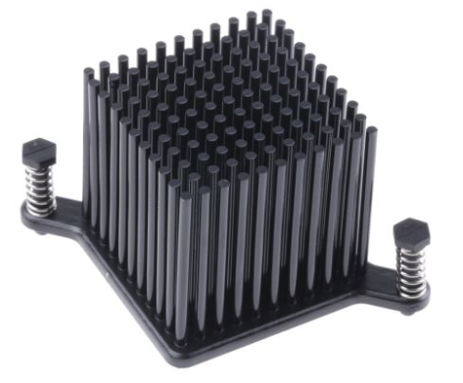
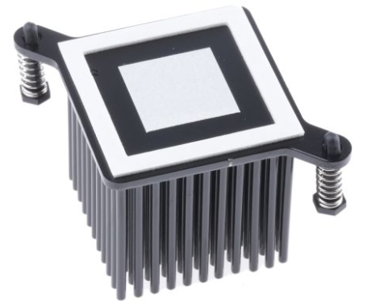
Heat Sink Selection – Option #6
L x W x H –37.5 x 37.5 x 33 – 2.4 C/W @ 100LFM, 1 m/s, 1.51 CFM
Link

